Slide 1
SFA By Field force
Retailer Creation in SFA
Retailer can Download the app using key
Retailers (App) is ready for Register
Retailer approval by admin
Mobile app link with unique Key send to Retailer Mobile once approved

Slide 2
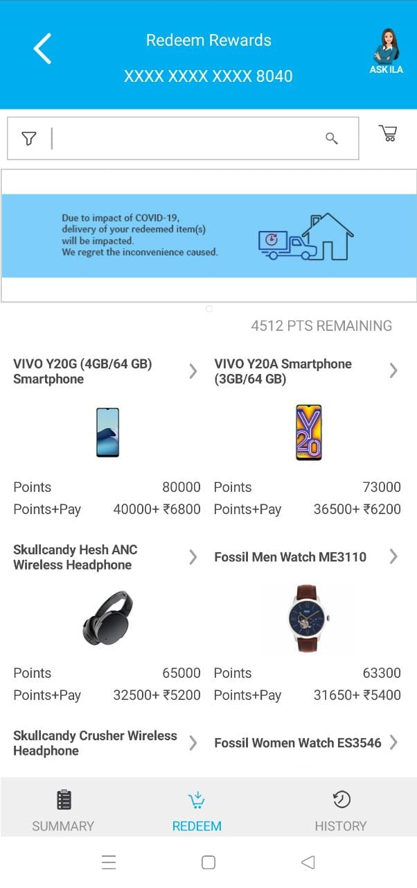
Retailer App Registration
Name
Mobile
Email
Register ID
Submit
Retailer App login
Profile updation like Name
Mobile
Email Id
Communication address for Delivery
Gift list and rewards points shows)
Claim Rewards
(sample screen attached)

Slide 3
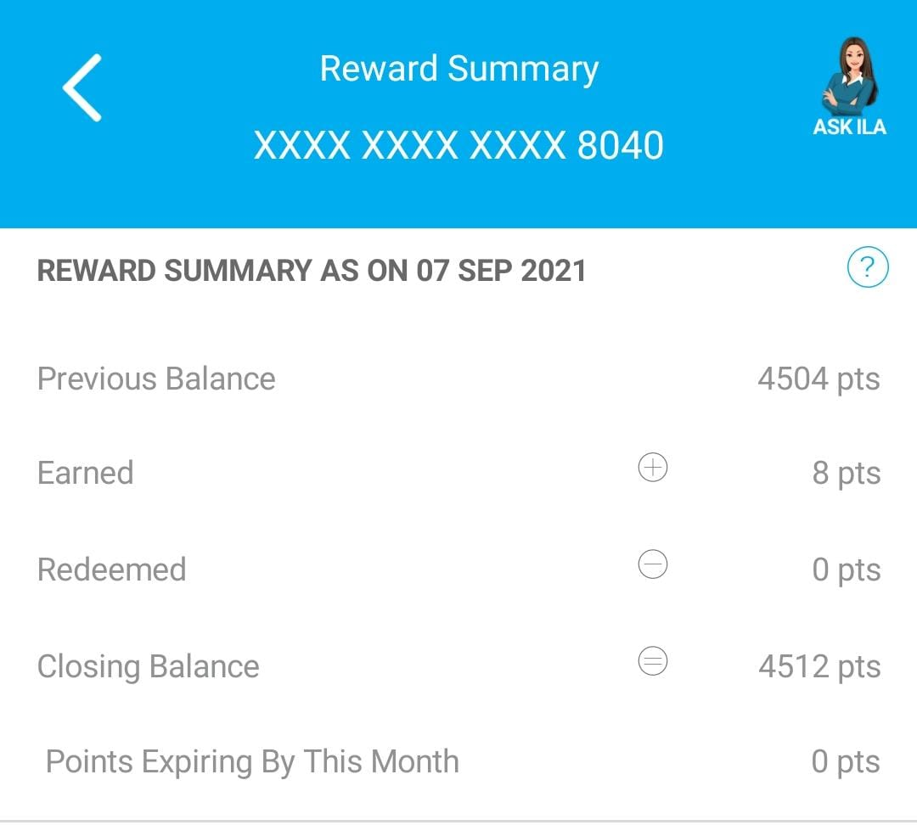
Track My Rewards
My Rewards
My orders
Logout

Slide 4
Admin Web Login
Retailer approval menu creation.
Gift product master list upload screen
Reward points entry screen
Reward claim approval and reject.
Retailer Approval
Mobile app link Share option enabled once Retailer registration is approved
Mobile app link send to retailer registered mobile number with unique key
Retailer can download the app and view the reward status and gift products available to claim
Gift Master
Gift Name creation and upload with image
Value of the Gift products

Slide 5
Reward Point Entry
Reward point entry for the Gift products
Reward points summary Report (sample format)
Sl.No | Retailer Name | Route Name | Phone No | Value | Points
1 | ABC Store | Mumbai | 9876543210 | 35000 | 3500
2 | XYZ Medical | Chennai | 1234567891 | 42775 | 4280
Claim Approval
Claim status report for all raised by retailer
Admin will approve the claim (claim approval screen)
Claim status report with all retailer details (Name, Contact No, Gift Name, Delivery address etc)
Sl.No | Retailer Name | Route Name | Phone No | Rewards Points | Redemed | Balance Points | Gift Claimed | Approve | Reject | Reject Reason
1 | ABC Store | Mumbai | 9876543210 | 3500 | 3100 | 400 | Ion Box | Approve | Reject | Reject Reason
2 | XYZ Medical | Chennai | 1234567891 | 4280 | 4100 | 180 | Rice cooker | Approve | Reject | Reject Reason

Slide 6
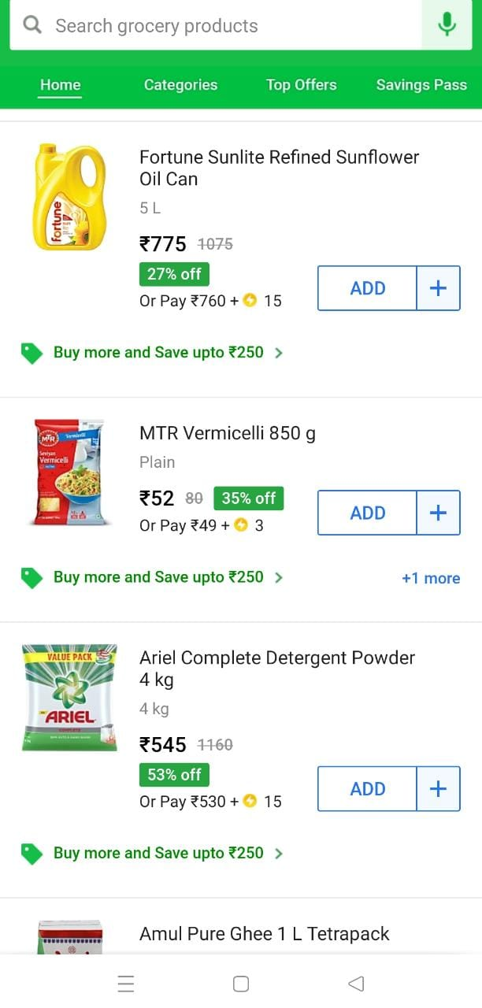
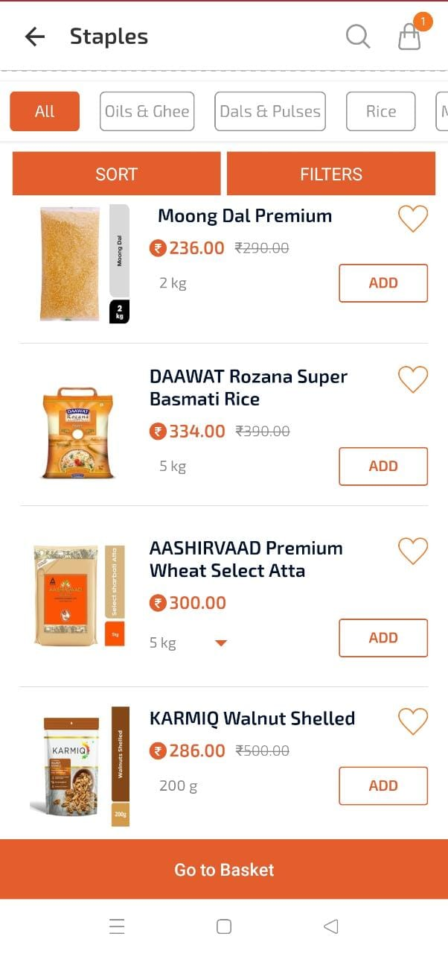
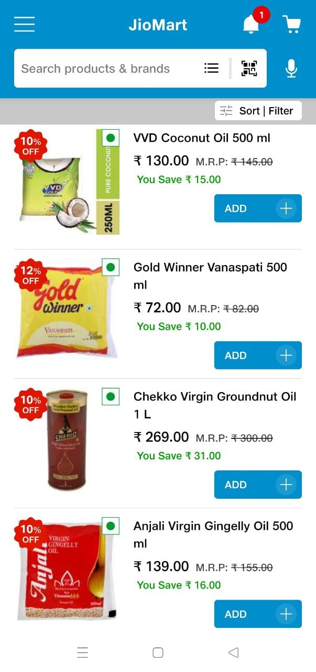
Product list and gift list sample in Retailer app

Slide 7
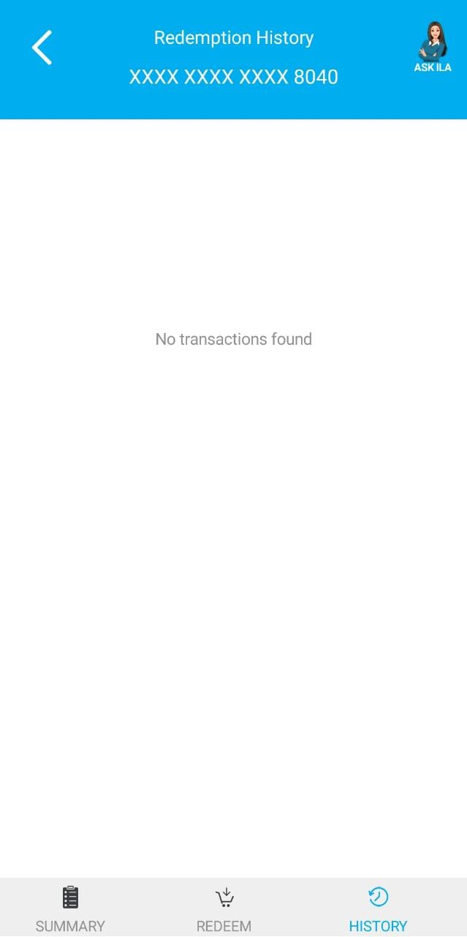
Reward claim and summary sample

